Slide 1
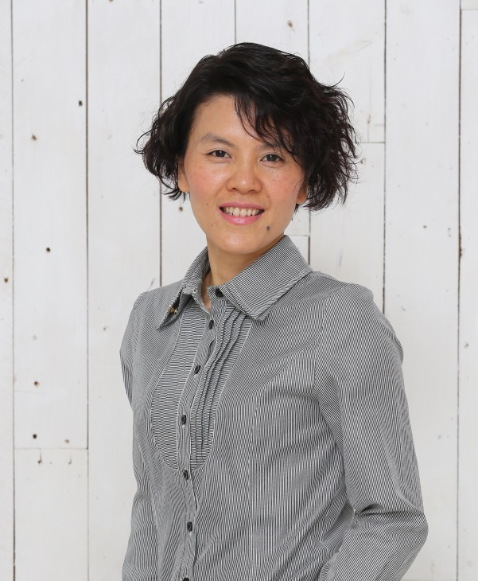
如何運用Master UFO建立UFO團隊
Master UFO program Action plan for success
Kawae Cheung
顧問經理級
Supervising Coordinator
四個佣金週期共賺取HK$57,500
HK$57,500 in 4 Commission weeks
本簡報中提到的收入等級純屬舉例說明，無意代表美安香港超連鎖店主的一般收入，也無意表示任何超連鎖店主皆可賺取同等收入。美安香港超連鎖店主的成功與否，取決於其在發展事業時的努力、才能與投入程度。The income levels mentioned in the following presentation are for illustration purposes only. They are not intended to represent the income of a typical Market Hong Kong UnFranchise Owner, nor are they intended to represent that any given Independent UnFranchise Owner will earn income in that amount. The success of any Market Hong Kong Independent UnFranchise Owner will depend upon the amount of hard work, talent, and dedication which he or she devotes to building his or her Market Hong Kong Business.

Slide 2
如何運用Master UFO建立UFO團隊
Master UFO program Action plan for success
Kawae Cheung
策略及籌劃委員會成員
Hong Kong Leadership Council member
本地協調員 Local Coordinator
授證訓練員 Certified Trainer
UFO超連鎖店主 Master UFO
總裁挑戰賽得主
President’s Challenge Winner
本簡報中提到的收入等級純屬舉例說明，無意代表美安香港超連鎖店主的一般收入，也無意表示任何超連鎖店主皆可賺取同等收入。美安香港超連鎖店主的成功與否，取決於其在發展事業時的努力、才能與投入程度。The income levels mentioned in the following presentation are for illustration purposes only. They are not intended to represent the income of a typical Market Hong Kong UnFranchise Owner, nor are they intended to represent that any given Independent UnFranchise Owner will earn income in that amount. The success of any Market Hong Kong Independent UnFranchise Owner will depend upon the amount of hard work, talent, and dedication which he or she devotes to building his or her Market Hong Kong Business.

Slide 3


如何運用Master UFO
建立UFO團隊
Master UFO program
Action plan for success

Slide 4
甚麼是Master UFO
What is Master UFO Program?
It is a proven business plan.
一個已證實可行的行動計劃

Slide 5
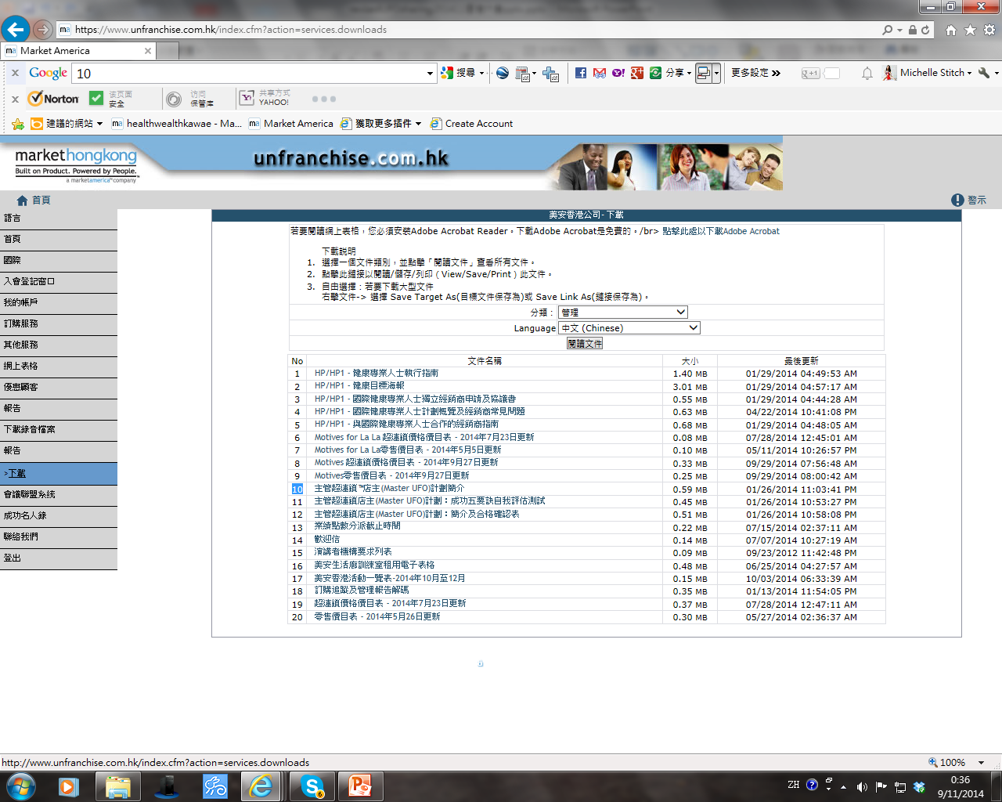

Slide 6
P.4 主管超連鎖™店主(UFO)標準
日曆季度合格確認表填寫須知
Calendar Quarterly Qualification
Verification and Validation Form Instructions
業務輔助資料要求
1. 填寫該季度購買至少港幣 $240 業務輔助資料的產品訂單號碼和訂單處理日期。
通訊及管理服務
1. 填寫超連鎖管理系統 (UFMS) 月費的訂單號碼。
Business Support Materials Requirements
1. Enter the Product Order Number used to purchase a minimum of $240 of business support materials for the respective quarter and the date in which the order was processed.
Communication and Management Services
1. Enter the order # for the UnFranchise Management System (UFMS) monthly fee

Slide 7
產品使用和零售要求
1. 在該日曆季度中購買總值為 1300 BV 的產品。這些產品必須由你或你個人登記的優惠顧客購買。
2. 在該日曆季度中購買總值為 45 IBV 的產品。這些產品必須由你或你個人登記的優惠顧客購買。
組織建立要求
1. 填寫在該季度親自推薦的兩位美安香港超連鎖店主姓名和會員號碼。
Product Use and Retail Sales Requirements
1.Purchase a total of 1300 BV of product for the respective quarter. These product purchases must be from your paying UFO ID or from a personally registered Preferred Customer’s paying ID.
2.Purchase a minimum of 45 IBV of product for the respective quarter. These IBV product purchases must be from your paying UFO ID or from a personally registered Preferred Customer’s paying ID.
Organization Building Requirements
1. Enter the names and the Market Hong Kong Identification Numbers of the two qualified UFO that you personally sponsored for the respective quarter.

Slide 8
培訓要求
1. 參加或主講過一次新超連鎖店主訓練 (NUOT)。
2. 參加或主講過一次成功五要訣訓練 (B5)。
3. 在一日曆年度內參加或主講過一次授證經理級訓練 (ECCT)。
4. 買至少三張領袖訓練會議或香港年會的門票。
Training Requirements
1. Attended or conducted one New UFO Trainings.
2. Attended or conducted one Basic Five Trainings.
3. Attended or conducted one Executive Coordinator Certification Training (ECCT) per calendar year.
4. Purchase a minimum of three tickets to Leadership School and Annual Convention.

Slide 9
晉升級別/獲取相應收入的要求
1. 將你的成功五要訣自我評估測試的首頁複印一份，分數應在 50% 以上。在確認表上簽名，並將該自我評估表首頁複印本與確認表一起遞交。
及/或
2. 填寫商業發展中心號碼，該中心在該季度的BV及/或 IBV至少為你賺得港幣 $6,900 的佣金。
Pin Level/Income Consistency Requirements
1. Make a photocopy of your Basic Five Diagnostic Test cover sheet in which you scored greater than or equal to 50%. Initial that you are attaching and submitting the copy of the cover sheet with this form.
AND/OR
2. Enter the BDC extension from which you earned a minimum of $6900 in commissions for the respective quarter. (BV and/or IBV)

Slide 10
為甚麼要做UFO
Why you have to be an UFO?

Slide 11
主管超連鎖™店主(UFO)計劃
美安香港超連鎖店主
成功架構系統
Master UFO Program
A Structured System of Success
for Market Hong Kong UnFranchise Owner
P.1 美安香港公司提供的是證實可行的事業計劃，而不是投機致富的遊戲，或者是俱樂部、業餘愛好之類的活動，這是一項事業。你跟隨系統做，系統就給你回報。你也許會問：這項計劃是不是可行？可不可以真的拿到每年港幣 $1,435,200 或更多的收入？這只是遲早和賺錢多少的問題。其實，真正的問題是：你願不願意用行動來實現你對自己和超連鎖系統的承諾？你在美安香港事業中能否成功，就是你是否願意承擔責任的直接反映。這一切都從你開始，你必須作出行動！只有完全徹底地理解、掌握、執行超連鎖事業發展系統的每一個環節，並使之成為一種習慣，兩到三年計劃才會實現！
Market Hong Kong provides a proven business plan — not a get-rich-quick scheme, a game, a club, a hobby or a program. This is a business. If you work the system, the system will work for you. It is not a question of “if” the plan works, or “if” you can earn $1,435,200 per year or more. The only question is when and how many times over. The real question is - Are you willing to make a commitment to yourself and the UnFranchise System by taking action? Your success with Market Hong Kong is a direct reflection of your willingness to take responsibility for your business. It starts with you — you have to take action. The Two- to Three-Year Plan only works when all the components and principles that make up the UnFranchise Business Development System are thoroughly understood, embraced, implemented, mastered and made into a habit!

Slide 12
1.培訓要求
Training Requirements
分享教育(門票)
知識就是力量
Share Education (Tickets)
Knowledge is power

Slide 13
「靶心概念」
由外到內，逐漸深入！
“BULLSEYE CONCEPT”
Work from the
outside in!
一對一介紹 (One - on - Ones)
新超連鎖店主訓練 NUOT
成功五要訣訓練 B5
授證經理級訓練 ECCT
超連鎖事業説明會 (UnFranchise Business Presentations)
本地研討會 (Local Seminars)
區域大會 (District Conference)
轄區年會(Regional Convention)
世界大會 (World Conference)
國際年會 (I n t e r n a t i o n a l C o n v e n t i o n)
你的目標應該是帶領更多「積極進取型」超連鎖店主
參加下一次國際年會…但是一切要從外環做起…
三對一介紹，二對一介紹，一對一介紹
Your goal should be to get as many “Go Now” UFOs to the next International Convention as possible …
But it all starts with the outside…
3-on-1s, 2-on-1s & 1-on-1s
Notes:
13
13
13

Slide 14

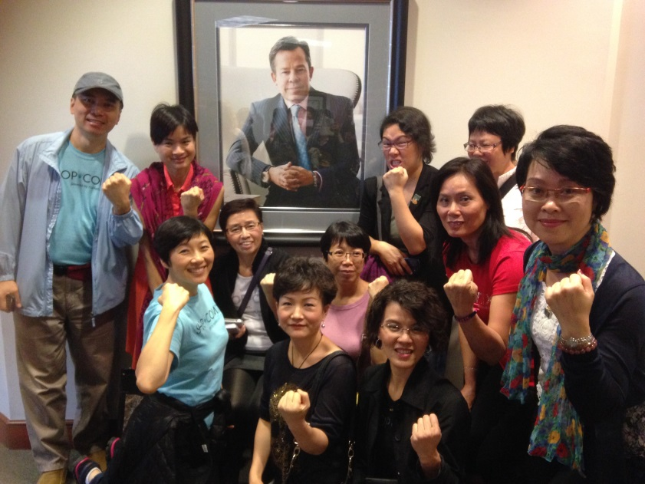
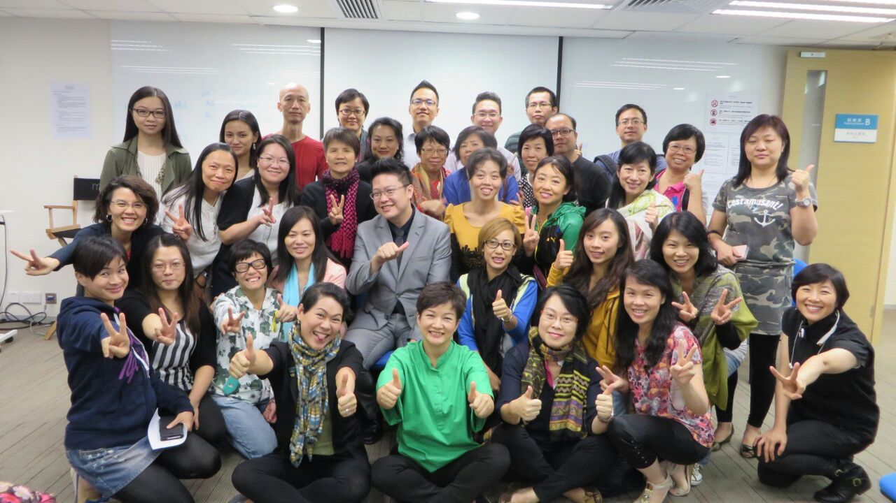
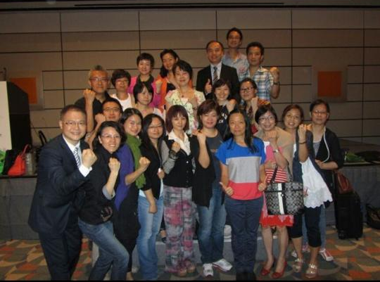
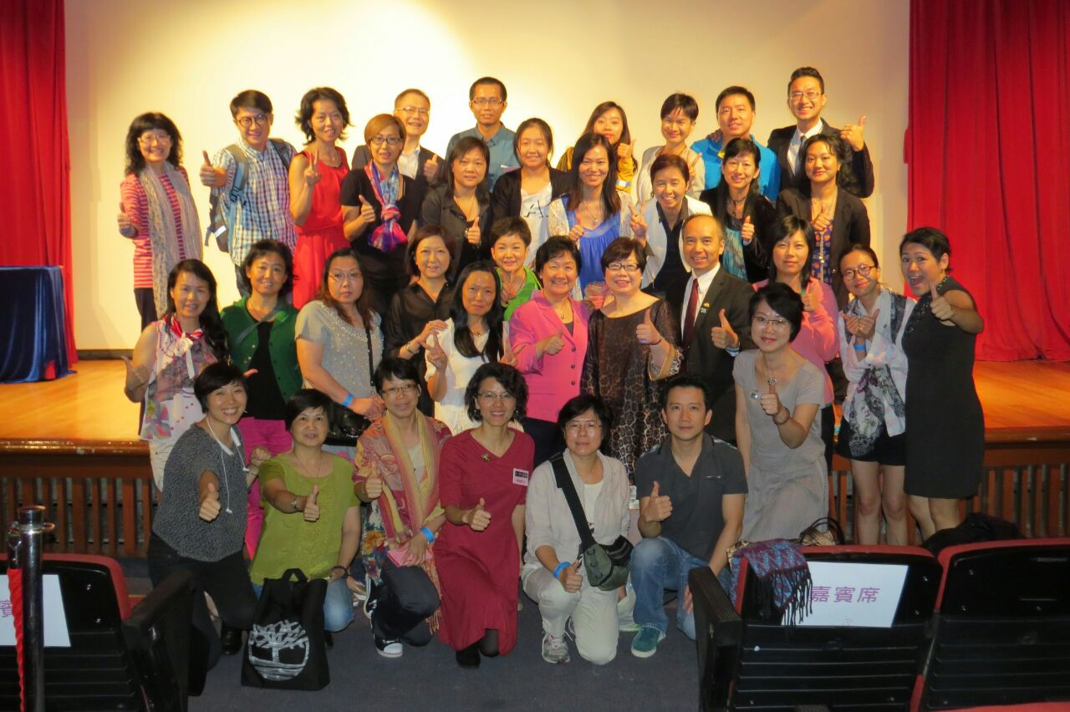
會議
聯盟系統
NMTSS

Slide 15
2.產品使用和零售要求
Use the Products and retail requirements
分享產品 (BV / IBV )
Share the Products (BV/IBV)
    自用心得
    一對一VIP服務
    跟進1-3-7-14-21
    現金回贈計劃
    產品目錄,產品見證
    工作坊体驗
    客人帶更多客人
Your own experience
1 on 1 VIP Service
Follow up 1-3-7-14-21
Cashback Program
Catalogs, testimonial
Workshop Experience
Guests bring more guests

Slide 16
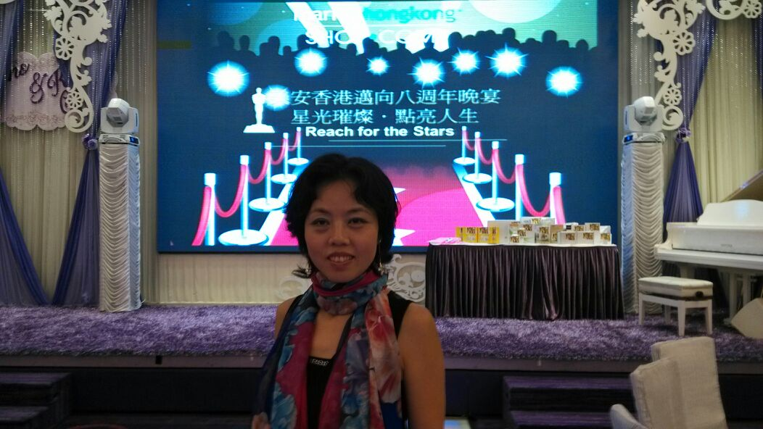
    卓越零售:助人為快樂之本
    The Excellent Retail :
    Helping others is one of the greatest sources of happiness
    倩:每星期500-800BV
    每月HK$2000-5000夥伴商店
    500-800BV weekly
    HK$2000-5000 Partner Store monthly

Slide 17
3.組織建立要求
Organization Building Requirements
分享事業(擴展)
Sharing the business (Expand)
    列名單
    分析名單
    學聊天,邀約
    Shop.com是甚麼
    Big Why
    (為甚麼做shop.com)
    展示計劃 MPCP
    Make a list
    Analysis of the list
    Learn how to chat
    with people, invitation
    What is Shop.com
    Big Why
    (Why you should run shop.com business)
    Show the plan, MPCP

Slide 18
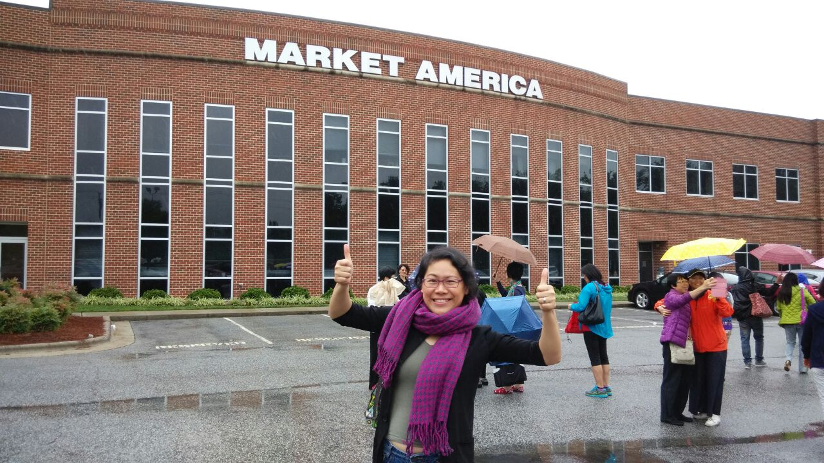
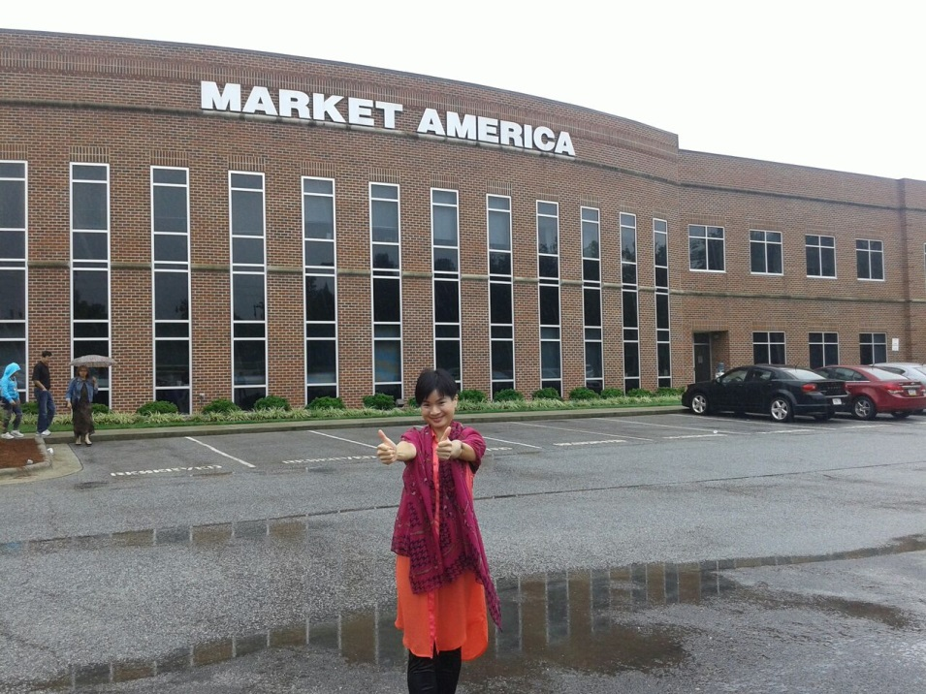
    卓越推薦:沒有做不到,只有沒想到
    The Excellent Sponsorship :
    what you can do is only limited by your imagination
    映緹:在第三季
    最後半日30/9推薦兩位
    Sponsored 2 UFOs in the last half a day 30/9 in Q3
    Tammy:在第四季
    10月推薦六位
    Sponsored 6 UFOs in Q4

Slide 19
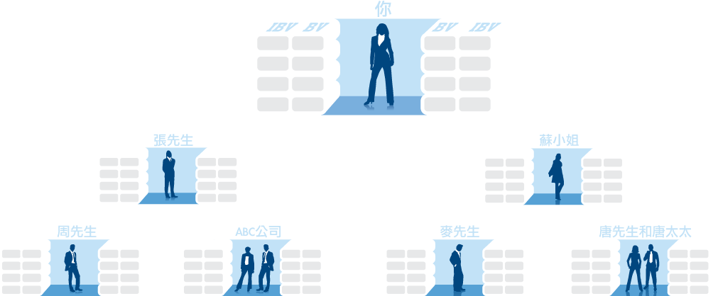
基本十顧客 七人強
Base 10 Seven Strong
1350BV / 45 IBV
1350BV / 45 IBV
450 BV / 15 IBV
450 BV / 15 IBV
450 BV / 15 IBV
450 BV / 15 IBV
450 BV / 15 IBV
450 BV / 15 IBV
450 BV / 15 IBV
顧客

Slide 20
UFO效益
The effectiveness of UFO

Slide 21
UFO 團隊成效
Team UFO Performance
 | UFO 合格人數 UFO Qualifiers | 總招募人數 Total Recruitment
第二季 Q2 | 8 | 17
第三季 Q3 | 5 | 22
第四季 Q4 Target | 12 | 35

Slide 22
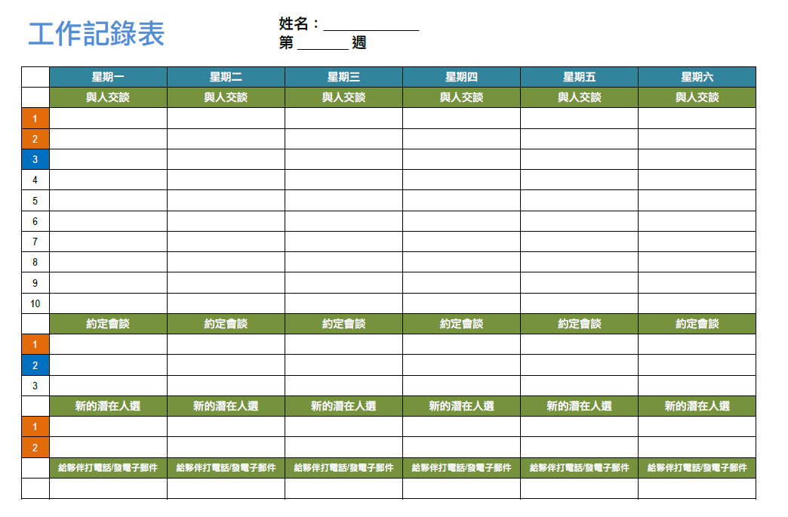

檢視,調整,修正
Review, adjustment, modification

Slide 23
小事成就大事,沒有奇蹟,只有累積
Trivial Accomplish Great Things, Nothing but Accumulation
每日每週每月做該做的事
Complete the tasks daily, weekly, monthly

Slide 24
UFO成功心得
UFO Successful Tips
目標導向
列名單
企業家態度 VS 打工
持續行動 VS 活動
讚美,鼓勵, 感恩
以身作則
團隊UFO
解決問題
Goal orientation
Make a list
Entrepreneur vs employee attitude
Continuous actions vs activity
Praise, encouragement, gratitude
With more solved problems comes larger residual income
Make yourself as an example
Team UFO
problem solving

Slide 25
解決問題的態度
Attitude of Problem-solving
老闆請你來是解決問題而不是制造問題；
如果你不能發現問題或解决不了問題，
你本人就是一個問題；
你能解决多大的問題，你就升多高的 超連鎖店主級別；
你能解决多少問題，你就能拿多少永續收入。
You’re hired to solve problems, not create.
If you could not find or solve problems, you are the problem.
The biggest problem you solved,
the highest UnFranchise Level you are.
How much can you solve the problems,
how much residual income you earn.

Slide 26

好問題建立好關係
Power Questions Build Relationships
問出對方真正想聽甚麼﹖
幫你學會聆聽
目標是否合乎本意
問內心的初衷
德國哲學家尼采︰
知道是為甚麼而活的人,
幾乎可以忍耐任何的怎麼做.
Ask people what they really want to listen?
Help you to learn how to listen
Whether the target in line with the intention
Ask the inner intention
Nitzsch, the German philosopher:
He who has a why to live can bear almost any how.

Slide 27
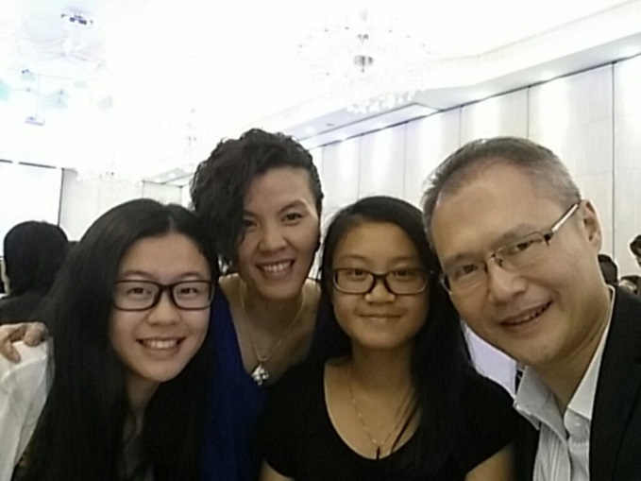
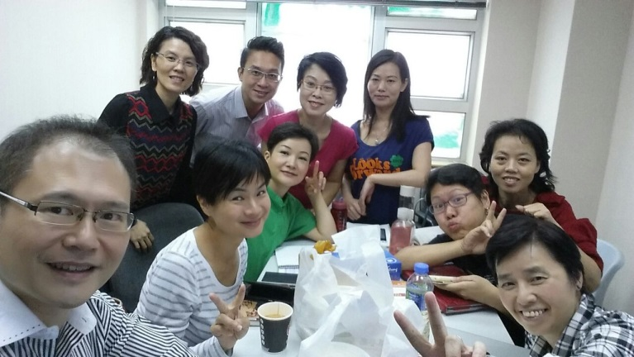
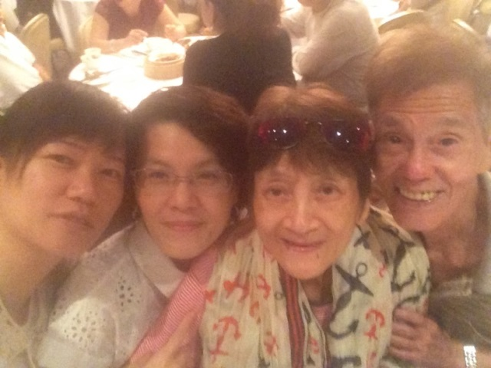
Kawae人生意義
The meaning of Kawae’s life
1. 同先生和一班志同道俠一起傳福音把愛活出來
2. 成為有能力幫助人的人
3. 建立信望愛 , 用生命影響生命
4. 陪伴一生最愛父母週遊列國
1. To share the evangelization and love with husband and friends
2. To have the ability to help others
3. To establish faith,hope,love and affect others
4. To accompany my beloved parents travel around the world

Slide 28
人因夢想而偉大，
因學習而改變，
因__ __而成功 !
Men are great for the dreams they have,
Change for the knowledge they learn,
Success for the _______ they have.

Slide 29
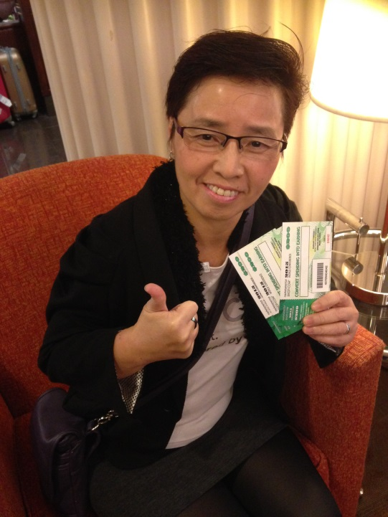
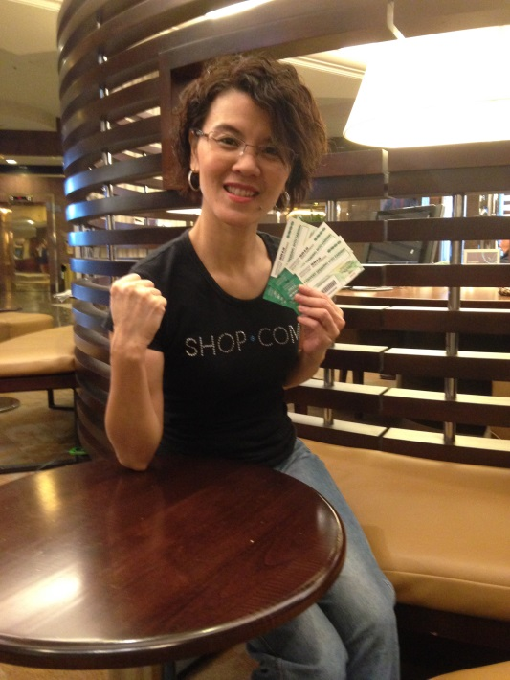
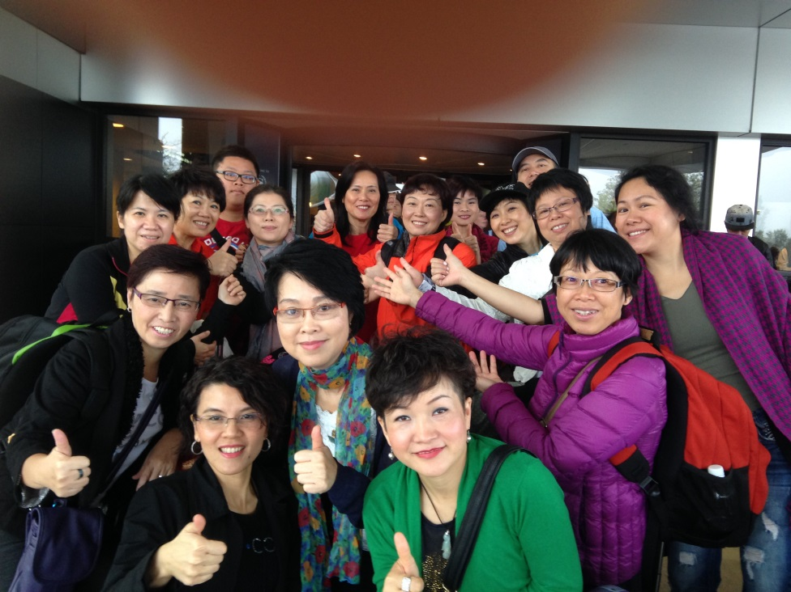
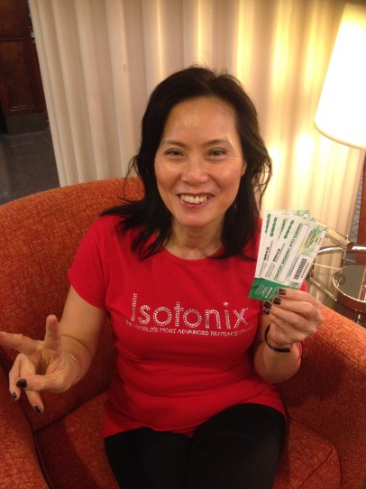
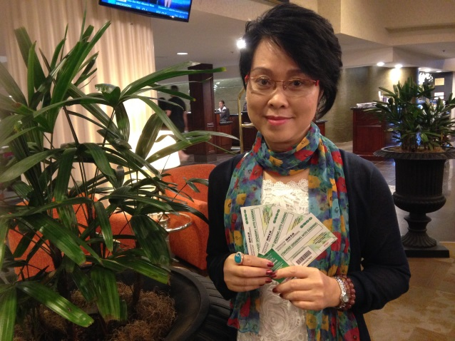
行動就是一切!
Just Do It!

Slide 30

謝謝 Thank you
祝大家一起更上一層樓
Strive for further improvement together

Slide 31



